Slide 1
Machine Learning
Morteza Maleki

Slide 2


Slide 3
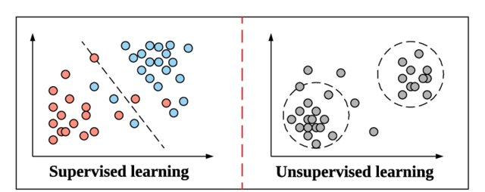

Slide 4
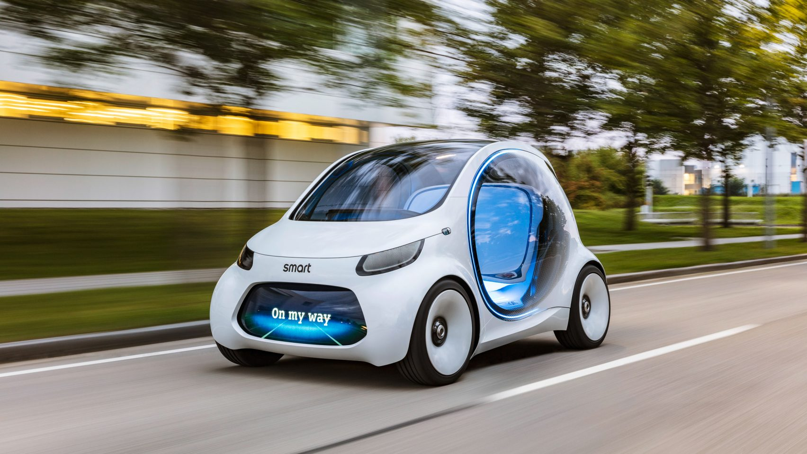
Self driving cars
RL

Slide 5
Compose in the style of Chopin starting with Mozart’s Rondo alla Turca
https://openai.com/blog/musenet/
GPT 2

Slide 6
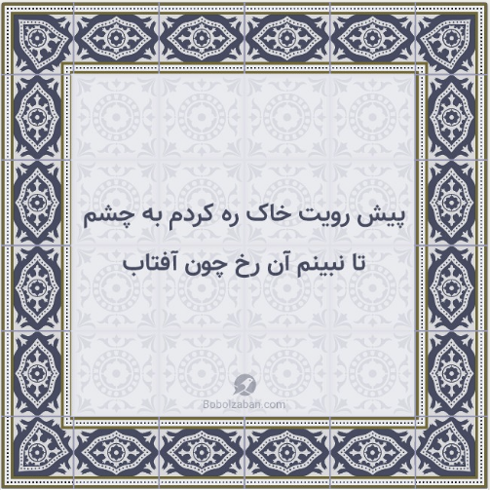
Persian one!
GPT2
Generative Pre-trained Transformer 2
http://www.bolbolzaban.com/about

Slide 7
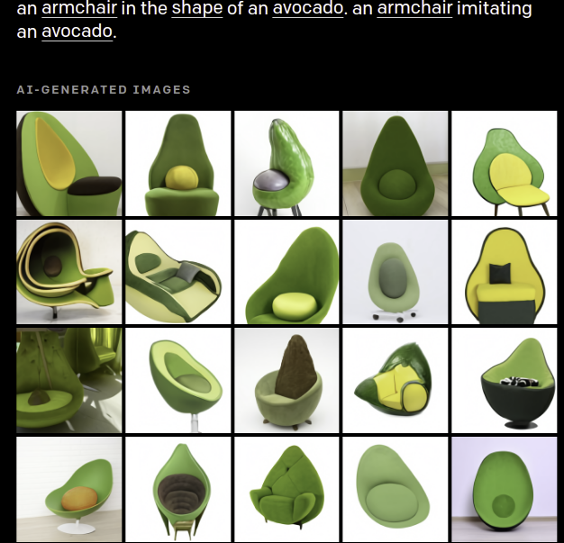
GPT3

Slide 8
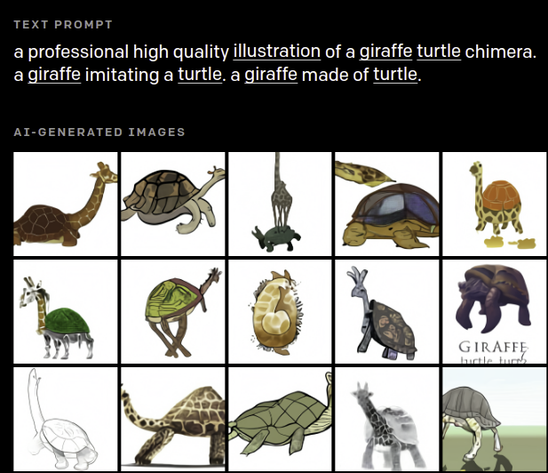
GPT3

Slide 9
Atlas robot can back flip

Slide 10
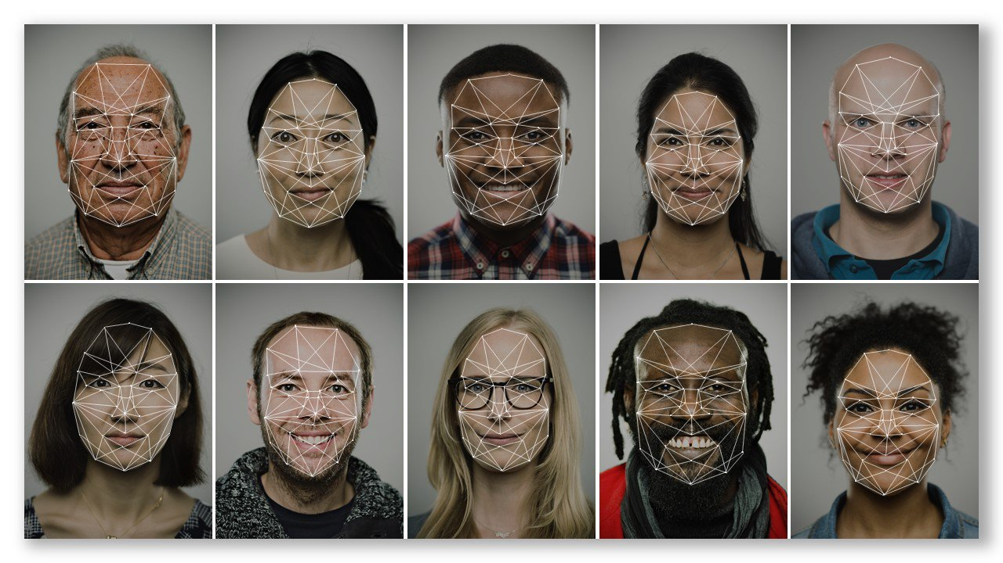
Face Recognition
CNN

Slide 11
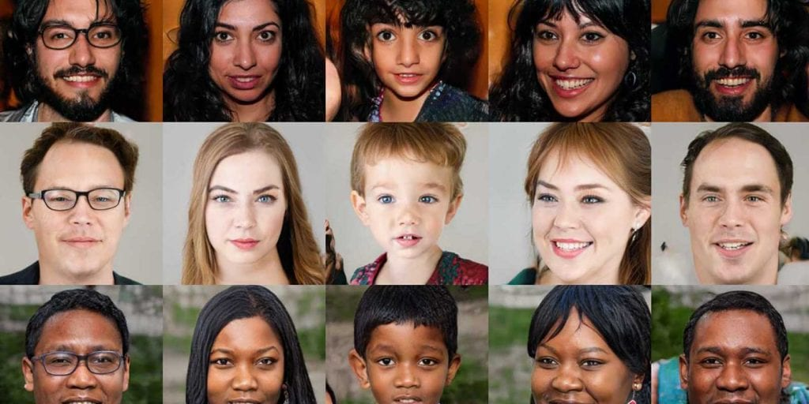
Generating images like real one!
Gan

Slide 12
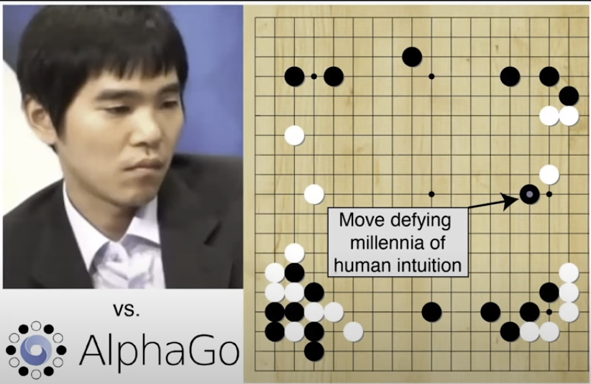
AlphaGo (Deepmind) VS Lee Sedol (South Korea )

Slide 13
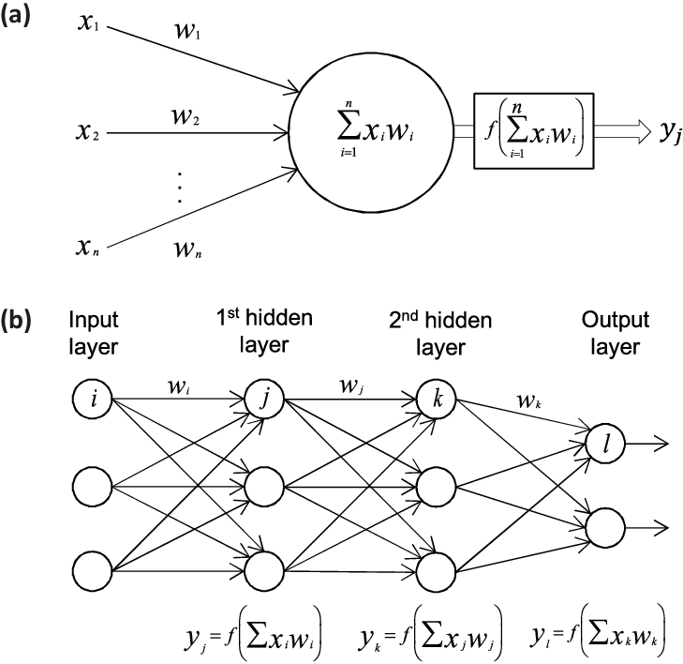
Neural Network Deep Learning

Slide 14
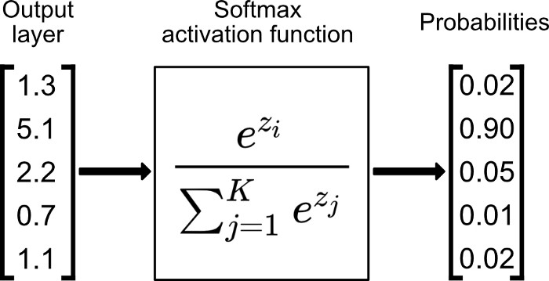
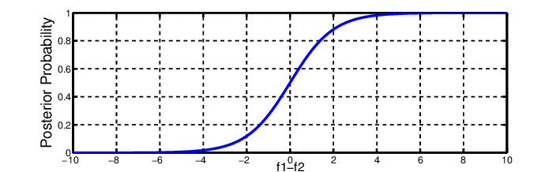
Deep Learning

Slide 15
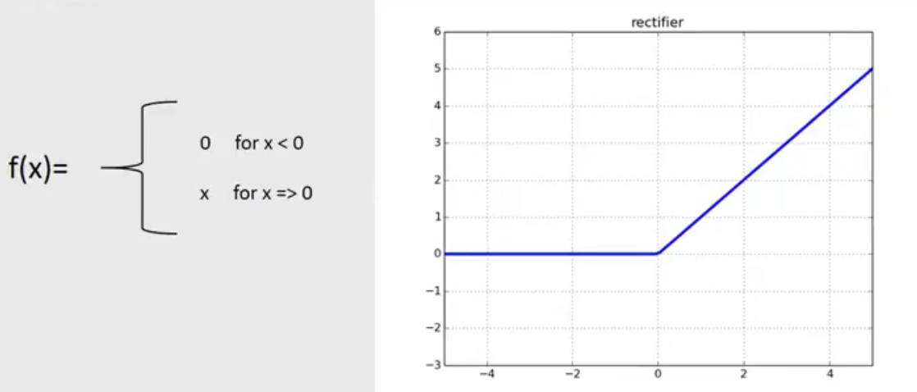
Deep Learning

Slide 16

Convolutional Neural Network

Slide 17

Convolutional Neural Network

Slide 18
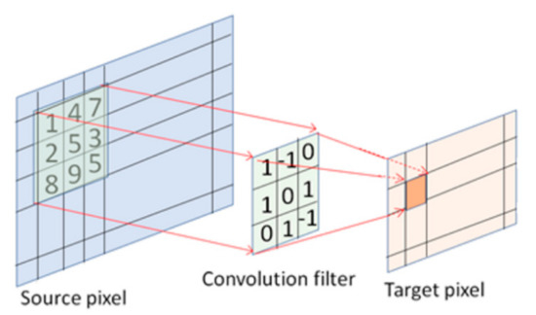
Convolutional Neural Network

Slide 19

Convolutional Neural Network

Slide 20
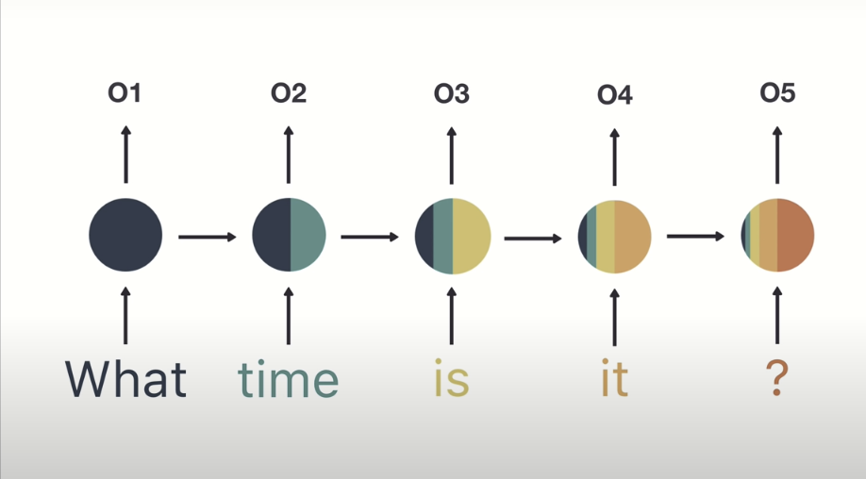
Recurrent neural networks(RNNs)

Slide 21
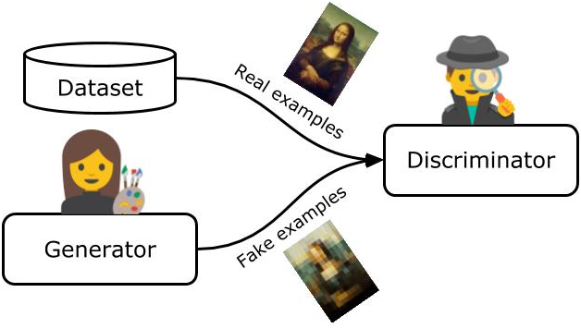
Generative Adversarial Network(GAN)

Slide 22
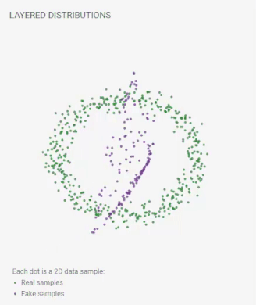
Generative Adversarial Network(GAN)

Slide 23
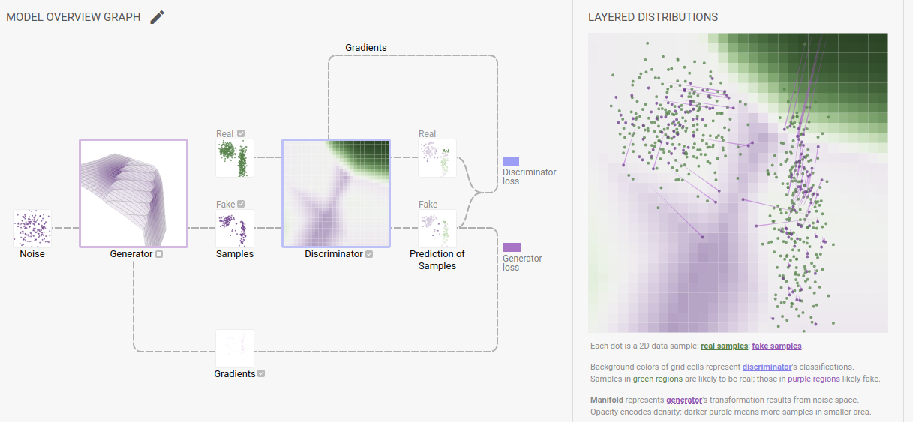
Generative Adversarial Network(GAN)

Slide 24
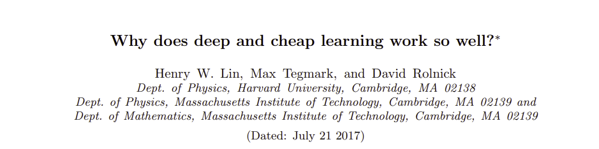
ML way of work? (maybe?!)

Slide 25
How to start??
How to start??
Is there a lot of probability and mathematics?
Do I need extraordinary programming skills?

Slide 26




How to start??
PYTHON

Slide 27
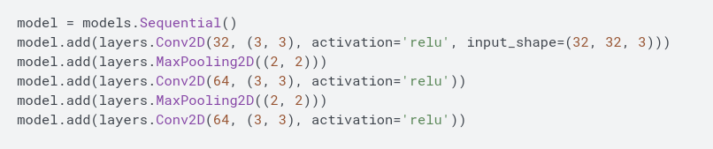
CNN tensorflow model example

